Slide 1
MATERNAL AND NEWBORN HEALTH I NORMAL PREGNANCY
MARCH 2020 KRCHN
RUGENDO .M. MORRIS
LECTURER
KMTC-KABARNET CAMPUS

Slide 2
Course objectives
Review the anatomy and physiology of the reproductive system. Both Female & Male
Explain physiological/ psychosocial changes in pregnancy.
Describe the fetal skull

Slide 3
REFERENCES
Myles textbook for midwives from 12th edition
A& P Ross and Wilson 11th edition
National Guidelines and strategies
NCK modules

Slide 4
ABDOMINAL EXAMINATION
RUGENDO

Slide 5
ABDOMINAL EXAMINATION
The abdominal examination consists of:
1 -Preparation for this
2 -Inspection
3 –Fundal palpation,
4 -Lateral palpation
5 -Pelvic palpation
6 -Auscultation
7 -Documentation and decision making

Slide 6
PREPARATION
It is important to carry out the usual essential care skills such as:
Introduce yourself to the woman
Consult the antenatal notes
Determine the level of risk and the maternity care needs of the woman
Respect hygiene measures and the privacy of the woman.

Slide 7
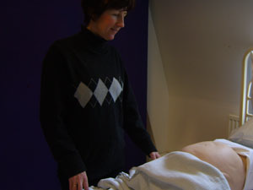
preparation

Slide 8
INSPECTION
The woman’s abdomen is inspected for it’s shape. This can indicate size and lie of the fetus, the amount of amniotic fluid and sometimes fetal movement may be noticed. Obvious scars will be seen and this information may be significant.

Slide 9
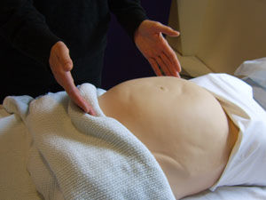
INSPECTION

Slide 10
FUNDAL HEIGHT
Fundal height Is measured to estimate whether this
is in keeping with the expected date of birth. This
can be done using landmarks i.e. xiphisternum,
where the fundal height can be measured by
fingerbreadths in relation to this, and the period of
gestation is calculated.

Slide 11
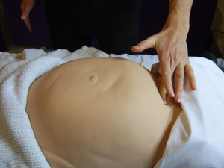
Fundal height

Slide 12
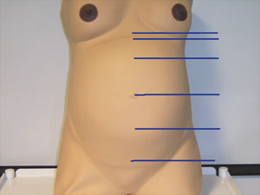
Estimating the fundal height

Slide 13
FUNDAL PALPATION
Using the flat interior of the tips of the middle fingers of both hands the fundus is palpated to identify the fetal pole (cephalic or breech). If no pole is located the lie is not longitudinal.
Fundal palpation is carried out to find out the lie and presentation of the fetus. Things which influence the fundal height are: maternal parity, size, full bladder, the lie and the number of fetuses. To determine what is found in the fundus a hand is placed on the abdomen below the xiphisternum and gently moved downwards until the fundus is felt.

Slide 14
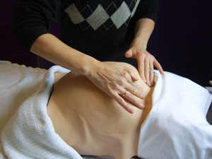
FUNDAL PALAPATION

Slide 15
LATERAL PALPATION
Lateral palpation assesses the main body of the uterus to confirm the lie and identify the fetal position. The fetal back is usually firmer and more regular in form than the other side of the fetus i.e. the abdomen and the limbs. One hand is placed on one side of the uterus to apply pressure, whilst the other attempts, using the flats of the fingertips, to identify what is found in the opposite side.

Slide 16
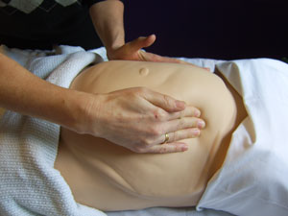
LATERAL PALPATION

Slide 17
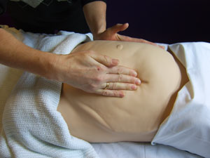
LATERAL PALPATION

Slide 18
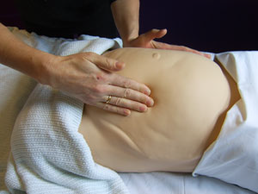
LATERAL PALPATION

Slide 19
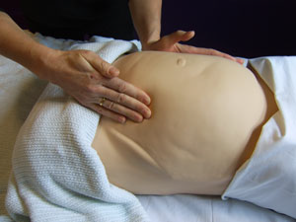
LATERAL PALPATION

Slide 20
LATERAL PALPATION
The same manoeuvres are then carried out on the other side of the uterus, that is the right hand held firmly on the mothers left side of the uterus and the flats of the insides of the fingertips identify the shape and form of the right side of the uterus.
Lateral palpation also provides insight into the size of the fetus, the tone of the uterus, amniotic fluid volume and also whether fetal movements are present.

Slide 21
Pelvic palpation
Pelvic palpation is used to identify the presentation, that is the part of the fetus lying in the lower pole of the uterus, over the pelvic brim. It can be determined whether:•the fetuses flexed or extended the presenting part is engaged or not the presenting part is mobile (ballotable), or engaging To carry out pelvic palpation both hands are used.

Slide 22
PELVIC PALPATION
One hand is placed on either side of the presentation and pressure is applied. The presentation can be felt. It may help if the woman takes a deep breath and blows out. Engagement of the presentation is assessed according to the passage of the widest diameter of the presenting part through the pelvic brim.

Slide 23
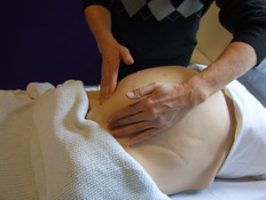
Pelvic palpation

Slide 24
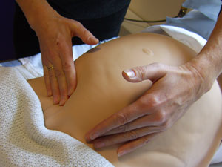
Pelvic palpation

Slide 25
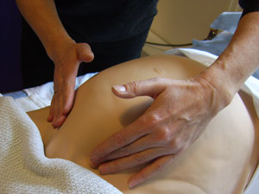
Pelvic palpation

Slide 26
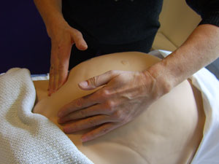
Pelvic palpation

Slide 27
Auscultation
The fetal heart is assessed for its presence, its rate and its regularity. The normal heart rate is between 110 & 150 beats per minute.
This is easy to distinguish from the maternal heart rate, which must also be assessed to determine that the fetal heart is actually being listened to.
Following the procedure the findings are discussed with the mother and documentation and follow up carried out as appropriate.

Slide 28
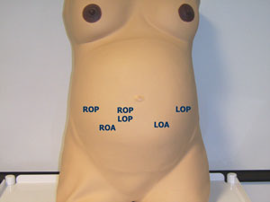
Points of listening to the fetal HR

Slide 29
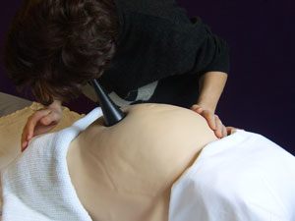
auscultation

Slide 30
Records
Records of the abdominal examination should include the following features: the fundal height, the lie, presentation and degree of engagement, the position (if identified), the fetal heart rate and whether fetal movements are felt.

Slide 31
Abdominal examination during pregnancy
Abdominal examination provides the woman with information that pregnancy is progressing well. She can be reassured regarding fetal growth and fetal wellbeing. Other examinations and tests are used in conjunction with the abdominal examination, for example ultrasonic scan.

Slide 32
Abdominal examination during labour
It is undertaken to assess progress and to help make decisions regarding the care required by the woman during labour.
This examination is used with other information for example: input from the woman findings from vaginal examination and other maternal and fetal information (blood tests, scans, other information gathered).

Slide 33
Abdominal examination during labour
Reasons for carrying out abdominal examination in labour are:
to determine the gestational age, the lie, the position, presentation and engagement of the fetal head and to listen to the fetal heart.
The progress of labour is assessed as is descent and rotation of the presenting part.

Slide 34
Abdominal examination during labour
Reasons for carrying out abdominal examination in labour are:
Abdominal examination is always carried out prior to auscultation and before fetal monitoring (CTG).
done before performing the vaginal examination. It is important to carry out abdominal examination between multiple births, for example, after the first twin and the first and second triplet.

Slide 35
Fertilization
Fertilization takes place when the sperm meets the ovum in the fallopian tube.
After ovulation, the ovum passes into the fallopian tube and is moved along by the cilia and the peristaltic muscular contraction of the tube.
Cervix produces alkaline mucus that attracts the spermatozoa.
When intercourse takes place many spermatozoa (about 300 million) are deposited in the upper vagina.

Slide 37
Focused Antenatal Care

Slide 38
Definition of antenatal care
Antenatal care (ANC) is health care given to a pregnant woman from conception to the onset of labour.
Aim of antenatal care
To achieve a good outcome for the mother and baby and prevent any complications that may occur in pregnancy, labour, delivery and the post partum period

Slide 39
The approach
The risk approach to antenatal care has not resulted in significant improvement in maternal survival. Life threatening complications of pregnancy are difficult to predict with any degree of certainty. Health care providers must, therefore, consider the possibility of complications in every pregnancy and prepare clients accordingly.

Slide 40
FANC: Focused antenatal care
Focused or targeted ANC refers to a minimum number of four comprehensive personalized antenatal visits, each of which has specific items of client assessment, education and care to ensure prevention or early detection and prompt management of complications. The focus is on birth preparedness and on individuals in readiness to handle complications. Always view each visit as if it were the only visit the woman may make.

Slide 41
The objectives of focused antenatal
Early detection and treatment of problems
Prevention of complications using safe, simple and cost-effective interventions
Birth preparedness and complication readiness
Health promotion using health messages and counseling
Provision of care by a skilled attendant

Slide 42
Schedule of Visits
It is recommended that the pregnant woman should attend a minimum of four comprehensive personalized antenatal
First visit less than 16 weeks
Second visit 16 - 28 weeks
Third visit 28-32 weeks
Fourth visit 32 – 40 weeks

Slide 43
The first visit:
Content of the first visit
Obtain information on:
Personal history
Name
Age (date of birth)
Physical address and telephone number
Marital status
Educational level:
Economic resources: employed? Type of work, position of patient and husband/guardian
Tobacco use

Slide 44
History of present pregnancy
Date of last menstrual period (LMP);
Quickening if applicable
Any unexpected event (pain, vaginal bleeding, other: specify)
Malaria attacks
Habits: smoking/chewing tobacco, alcohol, drugs (frequency and quantity)

Slide 45
Obstetric history
Number of previous pregnancies (Gravida and Parity)
Date (month, year) and outcome of each event (live birth, stillbirth, neonatal death, abortion, ectopic, hydatidiform mole)
Specify (validate) preterm births
Specify type and gestation of any abortion, and management if possible (MVA, D&C)
Birth weight of previous pregnancies (if known)
Sex of the baby / babies
Puerperium (eventful or uneventful)
Periods of exclusive breast-feeding: when? For how long?

Slide 46
Special maternal complications and events in previous pregnancies;
recurrent early abortion
induced abortion and any associated complications
thrombosis, embolus
hypertension, pre-eclampsia or eclampsia
placental abruption
placenta praevia
placenta praevia
breech or transverse presentation
obstructed labour, including dystocia
third-degree tears
third stage excessive bleeding
puerperal sepsis
Gestational diabetes.

Slide 47
Obstetrical operations:
caesarean section (indication, if known)
forceps or vacuum extraction
manual removal of the placenta
destructive procedures (craniotomy, decapitation)

Slide 48
Special perinatal (foetal, newborn) complications
twins or higher order multiples
low birth weight: <2500 g
intrauterine growth restriction (if validated)
rhesus-antibody affection (hydrops)
malformed or chromosomally abnormal child
macrosomic (>4500g) newborn
resuscitation or other treatment of newborn
perinatal, neonatal or infant death (also: later death)

Slide 49
Medical history
Specific diseases and conditions:
tuberculosis, heart disease, chronic renal disease, epilepsy, diabetes mellitus
RTIs
HIV status, if known
other specific conditions depending on prevalence in the region, e.g. hepatitis, malaria, sickle cell trait

Slide 50
Medical history
operations other than caesarean section
blood transfusions
Rhesus D negative antibodies
current use of medicines: specify
Period of infertility: when? duration, cause(s)
Any other diseases, past or chronic; allergy

Slide 51
Perform physical examination
General appearance
Head to toe examination
Measure blood pressure, pulse, temperature
Record weight (kilograms) and height (metres) to assess the mother's nutritional status
Check for signs of anaemia: pale complexion, fingernails, conjunctiva, oral mucosa, tip of tongue and shortness of breath

Slide 52
Perform physical examination
Examine the chest, including breast exam and heart auscultation
Measure uterine size (fundal height)
Signs of previous caesarean section (scar)
Foetal presentation and heart sounds if applicable
Inspection of the external genitalia to assess for abnormalities:
FGM status: - Varicosities, warts, discharge

Slide 53
Perform the following tests:
Urine: test for proteinuria, acetone and sugar for all women and urinalysis for bacteriuria
Blood: syphilis (VDRL or RPR)
Blood-group typing (ABO and rhesus)
Haemoglobin (Hb)
Counseling and testing for HIV
Sputum for AFB if indicated

Slide 54
Implement the following interventions:
Iron and folic acid supplements to all women
If test for syphilis is positive: treat
Tetanus toxoid ( See the 5 TT schedule as per the Kenya guidelines)
Refer woman when complications arise that cannot be managed at that facility, e.g.:
Severe anaemia, Hb <7.0 g/ml
Antepartum Haemorrhage
High blood pressure (>140/90 mm Hg)
Intra-uterine growth restriction / IUCD
Underweight, use mid upper arm circumference(MUAC)

Slide 55
Refer woman when complications arise
Polyhydramnios
Tuberculosis
Opportunistic infections / AIDS
If the first visit is after 16 weeks, give:
In malaria endemic areas: sufadoxine/pyrimethamine (IPT), three tablets once to be taken at the facility under supervision(DOT)
Mebendazole 500mg stat

Slide 56
Assess the need for specialised care
Determine whether the woman is in need of special care and/or referral to a specialized clinic or hospital. The following conditions might require specialised care:
Diabetes
Heart disease
Renal disease
Epilepsy
Drug abuse
Family history of genetic disease

Slide 57
INDIVIDUAL BIRTH PLAN
The Expected Date of Delivery (EDD)
The danger signs in pregnancy, childbirth and the postpartum period.
The danger signs for the newborn.
She should decide on who will be the skilled attendant at her delivery and where
She should be advised to identify a birth companion
What transport she will use before, during labour and after delivery if complications arise
How she will raise funds for transport, delivery charges and for essential items/supplies

Slide 58
INDIVIDUAL BIRTH PLAN
Identification of possible blood donors in case of haemorrhage
Her postpartum contraception plans and subsequent reproductive goals
A decision maker is identified in case of emergency
Where women have a bad obstetric history like previous caesarean section, stillbirth, retained placenta / PPH, the Where multiple pregnancy has been diagnosed, the woman should be referred immediately to a CEONC facility for confirmation of the multiple pregnancy and planning for the delivery

Slide 59
Birth Plan and emergency preparedness checklist
Is the EDD known?
Has a skilled professional birth attendant been identified?
Has a facility been identified?
Has a birth companion been identified?
Has a decision maker been identified?
Are emergency funds identified?
Who is the custodian of the emergency funds?
Has financial support been identified?
Has means of transport been identified?
Has a blood donor been identified

Slide 60
Advice on complications and danger signs
Danger signs in pregnancy
Bleeding per vagina
Bleeding
Drainage of liquor
Severe abdominal pains
Severe headaches
Generalized body swelling
Reduced foetal movements
Convulsions

Slide 61
Danger signs in labour
Labour pains for more than 12 hours (sun rise to sunset)
Excessive bleeding
Ruptured membranes without labour for more than 12 hours
Convulsions during labour
Loss of consciousness
Cord, arm or leg prolapse

Slide 62
Danger signs in postpartum period (mother)
Excessive bleeding
Fever
Foul smelling discharge
Abdominal cramps or pains
Painful breasts or cracked nipples
Mental disturbances
Extreme fatigue
Facial or hand swelling
Headaches
Convulsions
Painful calf muscles

Slide 63
Danger signs in postpartum period (newborn)
Fast breathing(more than 60 breaths/minute)
Slow breathing less than 30 breaths per minute
Severe chest in-drawing - Grunting
Umbilicus draining pus /redness extending to skin
Floppy or stiff
Fever(temp 38 degree c and above
Convulsions
More than 10 skin pustules
Bleeding from stump/cut

Slide 64
DANGER SIGNS DURING POSTPARTUM
Excessive bleeding
Fever
Foul smelling discharge
Abdominal cramps or pains
Painful breasts or cracked nipples
Mental disturbances
Extreme fatigue
Facial or hand swelling
Headaches
Convulsions
Painful calf muscles

Slide 65
Health promotion,
Advice on personal hygiene, rest, nutrition, family planning, malaria, worm infestations, HIV/AIDS and PMTCT.
Give advice on safer sex.
Advise women to stop the use of tobacco
Counsel on breast-feeding of the last born child;
Counsel on exclusive and early initiation of breast-feeding Counsel on the signs of labour
In case of an emergency home delivery the mother should be encouraged to visit the health facility within 48 hrs for a postnatal check-up

Slide 66
Health promotion,
questions and answers, and scheduling the next appointment
Request the woman to record when she notes the first foetal movement
Questions & answers: time for free communication
Advise the woman to bring her partner (or a family member or friend) to later ANC visits so that they can be involved in the activities and can learn how to support the woman throughout her pregnancy, childbirth and postnatal period
Schedule appointment as per recommendations (state date, and hour). This should be written in the woman’s antenatal card and in the clinic’s appointment book.

Slide 67
The Second Visit:
a) Obtain information on:
Personal history
Note any changes since first visit
Check-up on habits: smoking, alcohol, other

Slide 68
Present pregnancy
Note abnormal changes in body features or physical capacity (e.g. peripheral swelling, shortness of breath), observed by the woman herself, by her partner, or other family members
Record symptoms and events since first visit: e.g. pain, bleeding, vaginal discharge (amniotic fluid or any other), and manage appropriately
Check for signs and symptoms of anaemia.
Note foetal movements; record time of first recognition
Review the individualised birth plan

Slide 69
Obstetric history
Review relevant issues of obstetric history as recorded at first visit.
Medical history
Review relevant issues of medical history as recorded at first visit
Note any inter-current diseases, injuries, or other conditions since first visit
Note intake of medicines, e.g. anti-TB, ARTs and check on compliance
Iron and folate intake: check on compliance
Note other medical consultations, hospitalization or sick-leave since last visit

Slide 70
) Perform physical examination
Measure blood pressure and pulse
Fundal height
Oedema
Other signs of disease: shortness of breath, coughing, others.
Vaginal examination: do only if indicated. If patient is bleeding or spotting, do not perform vaginal examination but refer for further management.

Slide 71
Perform the following tests:
Urine: repeat multiple dipstick test to detect urinary-tract infection, proteinuria, and sugar
Blood: repeat Hb if Hb at first visit was below 7.0 g/m1 or signs of anaemia are detected on examination.

Slide 72
Implement the following interventions:
Iron: continue; if Hb is <7.0 g/ml, consider further investigations
If bacteriuria was treated at first visit and test is still positive, consider culture, change treatment and/or refer
Tetanus toxoid in line with national guidelines
In malaria endemic areas: administer sufadoxine/pyrimethamine as per national guidelines
Administer mebendazole 500mg stat after 1st trimester

Slide 73
Re-assess for complications and possible referral
Reassess whether the woman has developed any new complications since first visit, and refer/manage appropriately
Hb <7.0 g/ml at first and present (second) visit
APH / spotting
high blood pressure (>140/90 mm Hg):
foetal growth restriction
gestation diabetes
reduced foetal movement
polyhydramnios
malnutrition
opportunistic infections
any other alarming symptoms or signs

Slide 74
The third visit:
Contents of the third visit
a) Obtain information on:
Personal history
Note any changes since second visit
Check-up on habits: smoking, alcohol, other

Slide 75
Present pregnancy
Note abnormal changes in body features or physical capacity (e.g. peripheral swelling, shortness of breath), observed by the woman herself, by her partner, or other family members
Record symptoms and events since second visit: e.g. pain, bleeding, vaginal discharge (amniotic fluid or any other), and manage appropriately
Check for signs and symptoms of anaemia.
Note foetal movements
Review the individualised birth plan

Slide 76
Obstetric history
Review relevant issues of obstetric history as recorded at first visit.
Medical history
Review relevant issues of medical history as recorded at first and second visit
Note any inter-current diseases, injuries, or other conditions since second visit
Note intake of medicines, e.g. anti-TB, ARTs and check on compliance
Iron and folate intake: check on compliance
Note other medical consultations, hospitalization or sick-leave since last visit

Slide 77
Perform physical examination
Measure blood pressure and pulse
Fundal height
Palpate abdomen for multiple pregnancy
Oedema
Other signs of disease: shortness of breath, coughing, others.
Vaginal examination: do only if indicated. If patient is bleeding or spotting, do not perform vaginal examination but refer for further management.

Slide 78
Cont.
Those that reach the light cervical mucus survive and propel themselves towards the fallopian tubes while the rest are destroyed by the acid medium of the vagina.
Many sperm will reach the fallopian tube where they meet the ovum.
During this journey the sperm mature and are capable of producing an enzyme known as hyaluronidase, which will help penetration into the ovum.

Slide 79
Fertilization cont…
Only one sperm will enter the ovum. After the sperm goes into the ovum, the membrane is sealed to prevent other sperm from entering.
The unfertilized ovum stays alive for about 24 hours and spermatozoa for up to 48 hours in the genital tract

Slide 80
Cont…..
The sperm and the ovum will each contribute 23 chromosomes to make a total of 46 chromosomes.
The fertilized ovum is now known as a zygote.
Embryo is the name given to the blastocyst for the period from implantation up to eight weeks.
During this period all the organs and systems of the body are laid down and thereafter they only grow.
From the eighth week through to delivery, the embryo is known as a foetus.

Slide 81
Cont……
OVUM +SPERM ZYGOTE MORULA
BLASTOCYST
TROPHOBLAST INNER CELL MASS
PLACENTA CHORION AMNION U.CORD FOETUS
MORULA

Slide 82
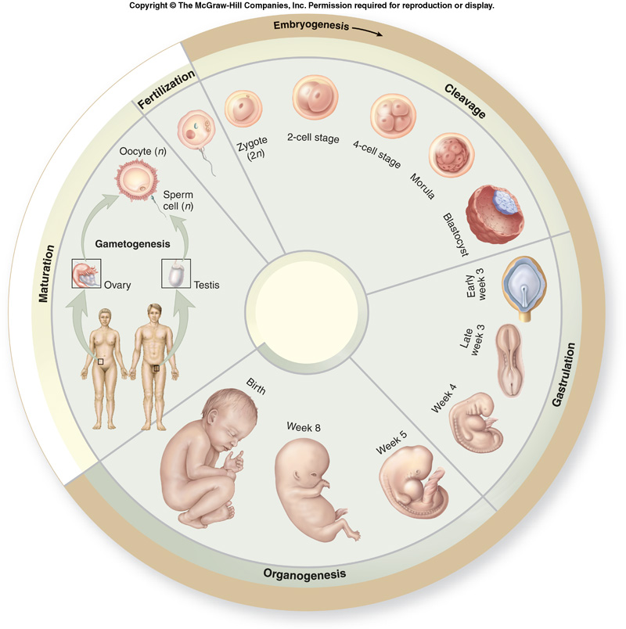
Developmental History of a Human

Slide 83
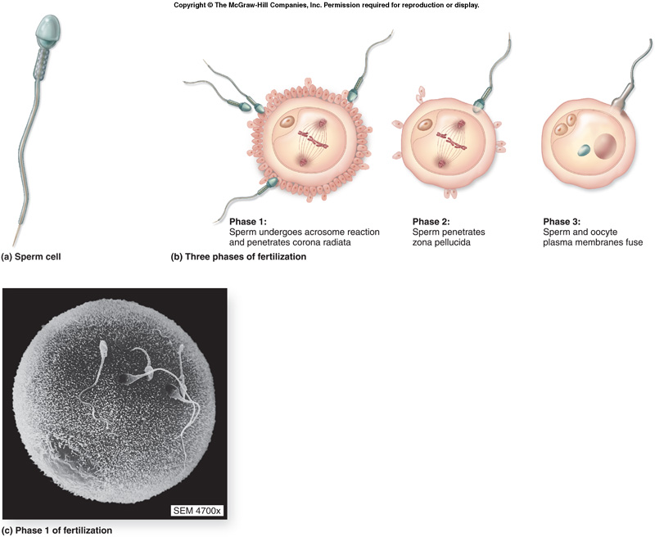
1. Fertilization

Slide 84
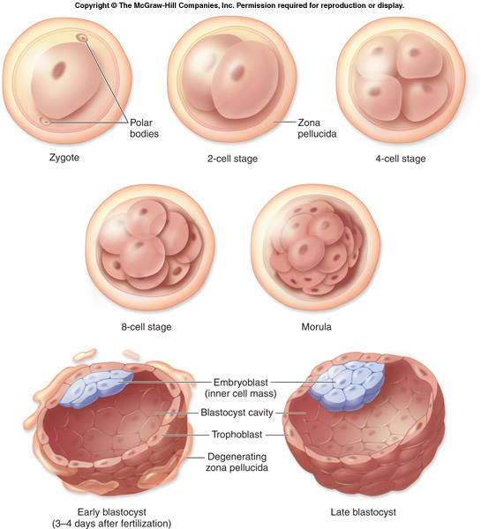
2. Cleavage

Slide 85
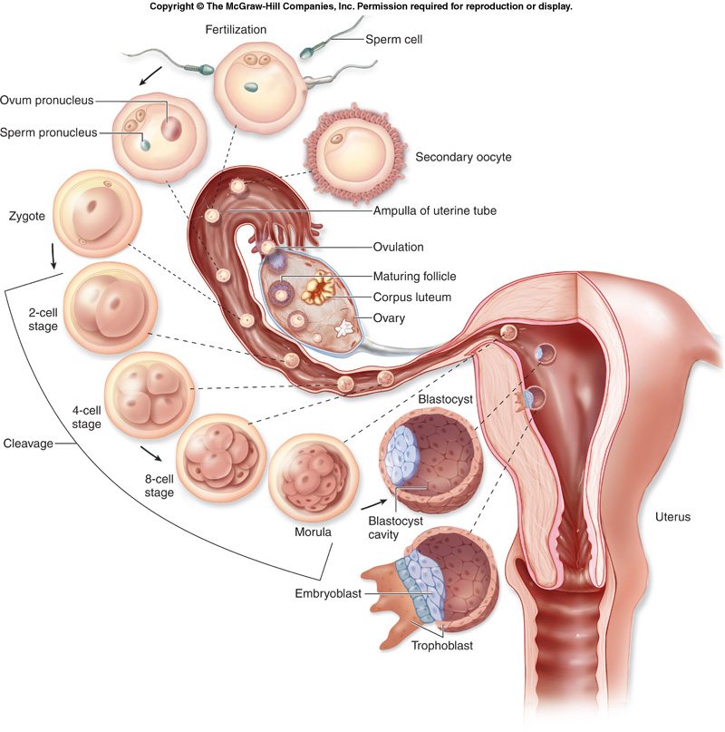
3. Morula
72 hours post-
fertilization
entering uterus

Slide 86
4. Blastocyst
Blastocyst has fluid-filled inner cavity
Evolves from morula on day 5

Slide 87
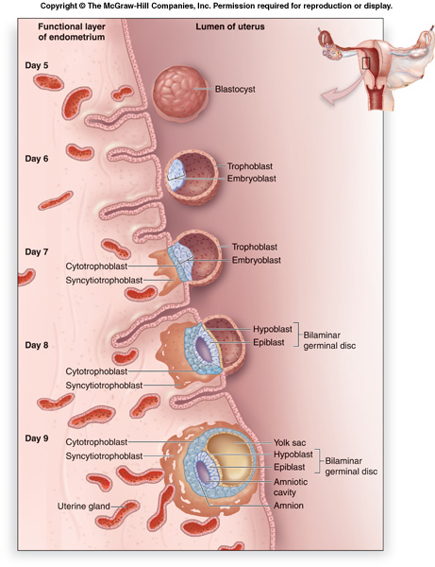
Implantation

Slide 88
Week 2
Implantation continues
Erosion of maternal blood
vessels
Complete emersion into
endometrium of uterus

Slide 89
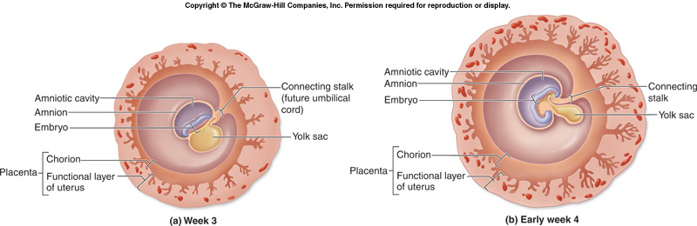
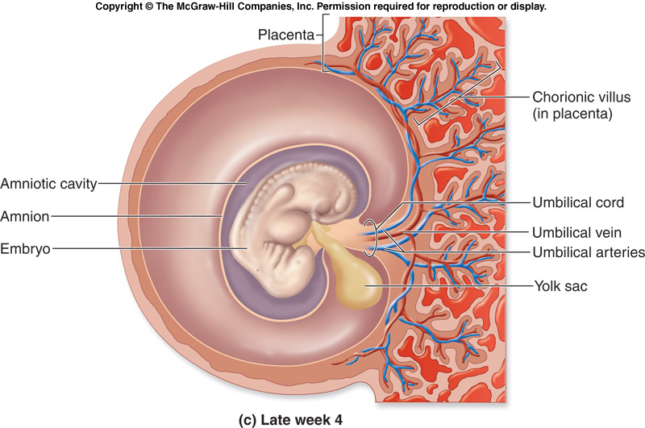
Weeks 3-4
Development of CV and nervous systems

Slide 90
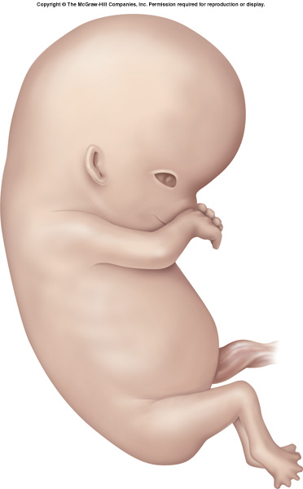
Weeks 5-8
Embryo will develop all structures that an adult has by the end of week 8

Slide 91
Embryo/Fetus
Embryonic period is weeks 1-8
Fetal period begins on week 9 and goes until birth at 38 weeks.
Embryonic period is characterized by development of structures (organs).
Fetal period is characterized by growth of those structures.

Slide 92
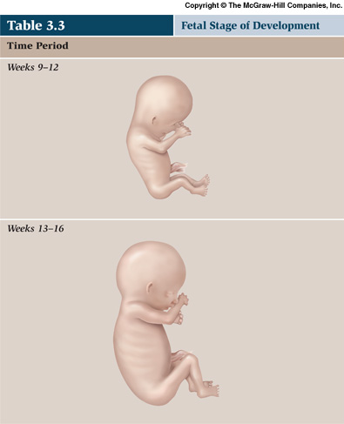
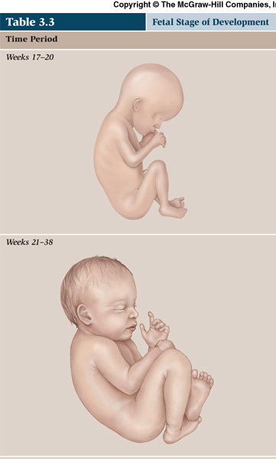
Fetal Period
9-12
13-16
17-20
21-38

Slide 93
The development of the embryo
0 – 4 weeks: Primitive central nervous system forms. The heart develops and begins to beat and limb buds form.
4 - 8weeks:There is very rapid cell division. Head and facial features develop and all major body organs are in place in primitive form. Early movements are visible on ultrasound.
8 – 12 weeks: Eyelids fuse and kidneys begin to function. From 12 weeks the foetus begins to pass urine. Lanugo appears
Circulation functions properly and sucking and swallowing begin. External genitalia present

Slide 94
Cont---------
12 – 16 weeks: There is rapid skeletal development and meconium is present in the gut. Nasal septum and palate fuse.
16 – 20 weeks: Mother feels foetal movements or quickening. Foetal heart is heard on auscultation.
20 - 24weeks: Most organs are able to function and foetus responds to sound. The skin is red and wrinkled.
24 – 28 weeks: May survive if born at this stage. There is respiratory movement and eyelids open.

Slide 95
Cont……..
28 – 32 weeks: The testes descend into the scrotum. Foetus begins to store fat and iron. Skin becomes less wrinkled.
32 – 36 weeks: The body is more rounded because of increased fat deposit and head hair is grown, nails reach finger tips and ear cartilage is soft.
36 – 40 weeks: Skull is firm and contours rounded. Birth is due.

Slide 96
The Placenta
Circular in shape, approx. 20 cm diameter, and 2.5 cm thick.
It weighs about 500g and is dark red in colour.
Develops from 14th day -16th wk
Its divided into 15 to 20 lobes by deep grooves.
The umbilical cord has two arteries and one vein
Review anatomical variations of placenta and cord
Describe fetal circulation

Slide 97
Functions
Respiration
Nutrition
Storage
Excretion
Protection
Endocrine

Slide 98
The Foetal Skull
The foetal skull contains a delicate brain, which may be subjected to great pressures as the head passes through the birth canal
The landmarks of the skull are described as:
• The vault, which lies between the orbital ridges and the nape of the neck- bones are thin and pliable so as to allow for alterations of the skull at birth, composed of the occipital bone, two parietal bones and two frontal bones.

Slide 99
Landmarks cont….
The base -comprised of firmly united bones that protect the vital centres in the medulla.
The face -composed of 14 small bones that are firmly united and cannot be compressed.
The mentum, also called the chin.

Slide 100
The regions of the skull are
The occiput, which lies between the foramen magnum and the posterior fontanelle. The sub-occipital region is the part below the occipital protuberance.
• The vertex, which is bounded by the posterior fontanelle, the two parietal eminences and the anterior fontanelle.
• The sinciput or brow, which occurs from the anterior fontanelle and the coronal suture to the orbital ridge.

Slide 101
The Foetal Skull - The Sutures
Sutures and fontanelles separate the bones of the skull from each other. These allow for a degree of overlapping during labour and delivery.
They are cranial points that are formed where two bones adjoin. They include:
The lambdoidal suture-separates the occipital bone from the two parietal bones.

Slide 102
Sutures cont…..
The saggital suture- lies between the parietal bones.
The coronal suture- separates the frontal bones from the parietal bones.
The frontal suture- runs between the two halves of the frontal bone, becomes obliterated with time while the other sutures become fixed joints.

Slide 103
The Foetal Skull - The Fontanelles
This refers to the point where two or more sutures meet. They include:
• The posterior fontanelle or lambda
Located at the junction of the lambdoidal and saggital sutures
triangular in shape and can be recognized per vagina.
Normally it closes at about six to eight weeks of age.

Slide 104
Anterior fontanelle or bregma
Located at the junction of the saggital, coronal and frontal sutures
Broad and diamond shaped and measures 3 to 4 centimetres long and 1.5 to 2 centimetres wide.
The average time of closure is 18 months, but the fontanelle may close as early as 9 to 12 months.

Slide 105
Diameters of the Foetal Skull
The foetal skull has eight measurements. There are two transverse diameters and six longitudinal or antero-posterior diameters.
The transverse diameters are:
• The biparietal diameter-between the two parietal eminences , 9.5 cm.
• The bitemporal diameter - between the furthest points of the coronal sutures and the temples. 8.2 cm

Slide 106
Longitudinal or Anteroposterior diameter
Sub-occipitobregmatic-9.5 cm running from below the occipital protuberance to the centre of the anterior fontanelle.
Sub- occipitofrontal- 10 cm, from below the occipital protuberance to the centre or the frontal suture.
Occipitofrontal, which measures 11.5 cm from the occipital protuberance to the glabella.

Slide 107
Diameters continued..
Mentovertical- 13.5 cm, from the point of the chin to the highest point on the vertex.
Sub-mentovertical-11.5cm, from the point where the chin joins the neck to the highest point of the vertex.
Sub-mentobregmatic, which measures 9.5 centimetres from the point where the chin joins the neck to the centre of the bregma.

Slide 108
Diameters
SOB -Sub-occipitobregmatic 9.5 cms
SOF -Sub-occipitofrontal 10.0 cms
OF- Occipitofrontal 11.5 cms
MV-Mentovertical 13.5 cms
SMV- Sub-mentovertical 11.5 cms
SMB -Sub-mentobregmatic 9.5 cms
Describe the presenting diameters in vertex, brow and face presentation

Slide 109
The Foetal Skull - Moulding
Term applied to the alteration in the shape of the foetal head that takes place during its passage through the birth canal.
Bones of the vault allow a slight degree of bending and the skull bones are able to override at the sutures.
The overriding allows a reduction in the size of the presenting diameters while the diameter at right angles to the presenting diameters is able to lengthen due to the give of the skull bones.

Slide 110
Cont,………………….
Moulding is a protective mechanism and prevents the foetal brain from being compressed as long as it is not excessive, too rapid or in an unfavourable direction.
If the foetal skull is subjected to abnormal moulding during normal delivery certain structures may be damaged

Slide 111
Physiological changes in pregnancy
The reproductive organs
The cardiovascular system
The respiratory system
The renal system
The gastrointestinal system
Endocrine system
Maternal weight
Musculo-skeletal system
The skin

Slide 112
Reproductive Organs
Uterus
Uterine muscle fibre increases in size (hypertrophy) and in number (hyperplasia)
60 grams - 900 grams. At term 1100g
Braxton Hicks contractions-8th week
Blood supply increases
ASSIGNMENT: review changes in uterine shape and size

Slide 113
Reproductive Organs
Cervix
Under the influence of progesterone, the endocervical cells secrete mucus, which becomes a cervical plug –operculum
In late pregnancy, the cervix softens in response to increasing painless contractions

Slide 114
Reproductive Organs
Vagina
More elastic due to oestrogen
Increased amount of the normal white vaginal discharge - leucorrhoea
Ph becomes more acidic to provide protection to some micro-organisms but also increases susceptibility to others such as candida albicans.

Slide 115
Cardiovascular System
Includes; heart, blood and B/vessels
Cardiac output increases from 5 litres to 7 litres per minute by late pregnancy
Caused by an increase in resting heart rate of about 15 beats per minute by the end of pregnancy and an increase in blood volume.
Red cell mass and plasma volume increases
Plasma increase is greater than that of the red cell mass- haemodilution effect-physiological anaemia
Review changes caused by increased plasma vol.

Slide 116
Other systems
Respiratory-amount of air inhaled per minute increases from 7 to 11 litres
In late pregnancy resp. rate increases due to compression
Renal System-dilation and kinking due to Progesterone which relaxes the walls of the ureters. Slowing down or stasis of urinary flow-predisposition to infection

Slide 117
Other systems
Gastrointestinal Tract-increased salivation
Changes in sense of taste leads to dietary changes and food cravings
Pica-Craving for substances such as bricks/soil
Gastric emptying and peristalsis reduced -maximise the absorption of nutrients
Gastric reflux due to relaxation of the cardiac sphincter
Constipation due to sluggish gut motility
Nausea and vomiting occur mainly during early pregnancy due to raised hormonal levels

Slide 118
CONT……………
Maternal Weight-continuous weight increase due foetus and fat deposition.
2 kilograms in the first 20 weeks followed by an average of 0.5 kilogram per week until term leading to 12 kilograms in total
Musculo-Skeletal System-relaxation of ligaments and muscles thus backaches and ligamental pain especially in the hip joint

Slide 119
CONT……………
Skin- increased activity of the melanin-stimulating hormone causes deeper pigmentation.
Deeper, patchy colouring on the face –chloasma
Linea nigra- pigmented line running from the pubis to the umbilicus
Thin stretch marks called striae gravidarum
Sweating – increased blood supply. progesterone- induced rises in temperature of 0.45°C together with vasodilation.

Slide 120
CONT……………
Breast
Enlarges due to increased tissue growth, blood supply and fat deposition.
Deposition of melanin toughens the nipple area in preparation for breastfeeding

Slide 121
Diagnosis of pregnancy
Signs
Possible/ presumptive-breast changes, amenorrhoea, morning sickness, bladder irritability, quickening
Probable-HCG in urine and blood, softened isthmus (hegar’s sign) blueing of vagina (Chadwick's) sign pulsation of fornices(osiander’s) uterine growth, skin pigmentation changes, uterine souffle, braxton hicks contractions, ballottement

Slide 122
Diagnosis continued……
Positive /confirmatory- visualisation of gestational sac, heart pulsation, fetal heart sounds, fetal movements, fetal part palpation, visualisation of fetus by x-ray
What are the gestation of the above signs and differential diagnosis?

Slide 123
DIAGNOSIS OF PREGNACY
Introduction
The diagnosis of pregnancy is usually made on the basis of
-hxo of amenorrhoea
-enlarging uterus
-positive pregnancy test
The manifestation of pregnancy are classified into 3 groups
Presumptive manifestation
Probable manifestation
Positive manifestation

Slide 124
PRESUMPTIVE MANIFESTATION
A) SYMPTOMS
1.Amenorrhoea
Cessation of mensis due to increasing eostrogen and progesterone levels produced by the corpus luteum of pregnancy. This is common in patient in with regular menstrual flow.
2. Nausea and vomiting
-Common symptoms
-occurs in more than 10% of pregnancies and is marked at 2-12/40 G.A due to increased level of Hcg

Slide 125
Cont
-severe in the morning but may occur any other time.
-extreme nausea and vomiting may be a sign of multiple gestation or molar pregnancy.
-Is associated with dehydration and ketonuria(hyperemesis gravidarum) which is a biochemical Diagnosis
Treatment is by
-rehydration
-light dry food
-emotional support
-anti emetic i.e prignodoxine ,promethazine,plasil etc

Slide 126
3. Breast changes
a) mastodynia-breast terdeness that range from tingling sensation to frank pain This is due to hormonal response.
b) Enlagement of the circumlacteal sebaious glands of the areolar( ontgomery’s tubercle) at6-8/40 G.A due to Hormonal stimulation.
c) colostrums secretion begins at 16/40 GA
d) secondary breast –become prominent in size and col0ration along the nipple line and hypertrophy of axilla breast tissue.

Slide 127
cont
4. Quickening
-perception of featal movement
- primigravida-18-22 weeks
Multiparous 16-18 weeks
5) Urinary tract symptoms
a) bladder iritability, frequency and nocturia due to bladder compression
b) recurrent U.T.I due to urine stasis

Slide 128
B. SIGNS
1. Inreased basal body temperature due to hormones.
2, skin changes
a)chloasma-mask of pregnancy start above 16/40 .
darkening of the skin- forehead,nose,checkbones.
b) linea nigra –darkening of the skin along the midline of the abdomen and in areolar and nipple due to increased melanocytes stimulating hormone.
c) stretch marks or striae gravidarum due to separation of collagen tissue due to adenocortisteroid response.

Slide 129
cont
d) spider telangiactasia-palmar erythema or skin lesion due to increased levels of eostrogen.

Slide 130
PROBABLE MANIFESTAION
A).Symptoms are as in presumptive manifestation
B).Signs
1. Pelvic organs- many changes are noticed by experienced physician/health workers
a). Chadwickcs sign-bluish or purplish discoloration of vagina & vagina and cervix due to pelvic congestion vasculature
b). Leukorrhea-increased vaginal discharge consisting of epithelia cell
c). Gododell’s sign- cynosis and softening of the cervix due to increased vascularity

Slide 131
cont
d). Ladin’s sign –uterine softening in the ant midline at 6 weeks of G.A
e). Hegar’s sign-widening of the softened area of isthmus leading to compressibility of isthmus on bimanual examination.
f). MacDonald’s sign –uterus flexible at ueterocervical junction at 7-8 weeks G.A
g). Von Fernwaid’s sign- irregular softening of the fundus over the site of implantation 4-5/52 .if occur at the cornual area is called piskacek’s sign

Slide 132
cont
f). Bones and Ligaments of the pelvis- there I s increase relaxation ,sometimes to a stretching degree
3. Abdominal enlargement –which is progressive from, 7-28/52. out of the pelvis into abdominal cavity.
4. Uterine contractions –uterus anlarge and become globular.
Painless contractions (Braxton Hicks) are felt as tightening pressures. They stat at 28/52 and disappear with walkng or exercise while true labour contractions become intense.

Slide 133
cont
5. Ballottement of uterus –palpable at 16/52 G.A , feels as a floating object above the pelvis.
6. Uterine soufle -Auscultation of abdomen after 16/52 elicits a rushing sound which is a pulse like due to movement of maternal blood filling through placenta vessels and sinuses within intervilli space.
Intensity vary from a whisper to a loud rash –it mask fetal Heart for many months.

Slide 134
Positive manifestation
Various s+s of pregancy are often reliable but non diagnostic. So positive diagnosis must be made upon objective finding .
A .Fetal Heart Tones.
auscultation with fetal scope is audible at 16 -18 /52. normal FHR 120-160 b/min .electronic device utilizing Dopler can detect FHT at 8 G.A
B. Palpation of fetus
can be palpable from 18/52 G.a

Slide 135
cont
C. X-ray of the fetus.
Should be avoided because of genetic or oncongenic risk but where benefit outweigh risk it can be done and will show ossified fetal bones > 12/52 and bowel shadow and pelvic bone configuration
D. Ultrasound exam of the fetus
Most useful technical aids in diagnosing and monitoring pregnancy. The fetal pole is seen at 7-8 /52 and heart tone is evidenced.
Can reveal every organ in the fetus.

Slide 136
cont
E . Pregnancy test
Most sensitive parameter in early pregnancy.
Measures changes in hcg produced by the syncytiotrophoblast after 8 days of fertilization and may be detected in maternal serum as early as 9 days and in urine within 21 days that is the 5th week from the LNMP.
Hcg peaks at 65 days and decreases in 2nd and 3rd trimester but it increases at 34 weeks.
Half life of hcg is 1-5 days so after termination of pregnancy levels drop to normal serum urine in 10 to 24 days.

Slide 137
Diagnosis of pregnancy at term
1.By obstetric physical examination
2.EDD/EDC
3. Amniotic fluid analysis by doing shake test/lecithin sphingomyline ratio/bubble test.
a tube containing 1mls amniotic fluid is mixed with 1mls of 95% ethanol is compared with a second tube containing 1mls of amniotic fluid, 0.5mls of ethanol and 0.5mls normal saline. Then shake the two tubes for 30 seconds. If a ring of bubbles form in the second tube L:S ratio of greater than 2 is assumed and baby is mature (lung maturity) to survive ex utero.
4. Obst U/S- by use of biometric measurement of the fetus-HC,BPD, AC and FL

Slide 138
DDX of pregnancy
Uterine myomas
Missed abortion
Ovarian tumours
H. mole
Choriocarcinoma
Malaria

Slide 139
FOCUSED ANTENATAL CARE
RUGENDO

Slide 140
Course Outline
Introduction to FANC
Aim of FANC
Integrated FANC services
TB
Malaria
PMTCT
Lab
CCC
STI
Tuberculosis in Pregnancy
Malaria in pregnancy

Slide 141
Introduction
Antenatal care is care that a woman receives during pregnancy to ensure healthy outcome for women and newborns
FANC is personalised care provided to a pregnant woman which emphasises on the woman’s overall health, her preparation for child birth and readiness for complications ( emergency preparedness)
It is timely, friendly, simple and safe service to a pregnant woman

Slide 142
AIM OF FANC
To achieve a good outcome for the mother and baby and prevent any complications that may occur in pregnancy, labour delivery and post partum

Slide 143
WHO Recommendations
Women can benefit from just a few antenatal visits as long as those visits are thorough
Ideally women should receive at least 4 thorough comprehensive , personalised antenatal visit, spread out during the entire pregnancy
Each visit should be viewed as if it were the only visit the woman may make. Many women cannot come for 4 visits

Slide 144
Four comprehensive, personalised antenatal visits
1st visit:<16 weeks
2nd visit:16-28 weeks
3rd visit:28-32 weeks
4th visit:32-40 weeks

Slide 145
Objectives of FANC
Early detection and treatment of problems
Prevention of complications using safe, simple and cost effective interventions
Birth preparedness and complication readiness
Health promotion using health messages and counselling
Provision of care by a skilled attendant

Slide 146
Objective 1: early detection & treatment of health problems
Service providers should identify existing medical, surgical or obstetric conditions during pregnancy such as:
Severe anemia (Hb<7g/dl)
Vaginal bleeding
Pre-eclampsia (increased BP,s severe edema)
STI’S , HIV/AIDS, TB and Malaria
Chronic disease(DM,heart or kidney problems)
Decreased/absent fetal movement
Fetal malpresentation after 36 weeks

Slide 147
Objective 2: Prevention of complications
Service provider ensures prevention/protection of complications by providing:
TT to prevent maternal & neonatal tetanus
Iron /folate supplements to prevent anaemia ( ferrous Fumarate )
IPT/ITNs to prevent malaria/anaemia
Ensure environmental hygiene to prevent intestinal worms
-Presumptive treatment of hookworm with mebendazole 500 mg STAT anytime after the 1st trimester inviting

Slide 148
Objective 3: Birth preparedness and complication readiness
Service providers should discuss components of birth plan which include:
Place of birth
Skilled attendant
Transport
Funds
Birth companion
Items for clean and safe birth for newborn
Knowledge of danger signs; what to do if they rise
Choose decision maker
Blood donor

Slide 149
Objective 4: Health promotion using health messages and counselling
Encourage dialogue on the following:
Nutrition
Rest & hygiene
Safer sex
Care for common discomforts
Avoidance of alcohol& tobacco
Use of IPT & ITNs
Drug compliance
Family planning/health timing and spacing of pregnancy
Early and exclusive breastfeeding
Newborn care

Slide 150
Objective 5: provision of skilled care at birth
Currently only 41% of pregnant women receive skilled care at birth
By 2015, it is expected that three quarter pregnant women should receive skilled care at birth
A skilled attendant offers services either at the health facility or within the community
FANC provides an opportunity to increase skilled care

Slide 151
During FANC visits ensure that the following have been accomplished
History taking
Current complaints/identify danger signs
Diet
TTvaccination
RH
History of presenting illness
Physical exam
General health
Swollen glands
BP, edema and proteinuria
Check for anaemia
Check baby’s growth
Provide
Iron folate, TT, ARVs
Counsel on
Danger signs
IBP
Complication readiness
Nutrition, breastfeeding, FP
PMTCT
Return date
ANC PROFILE
Lab work done during first visit
Sputum forAFB
Urinalysis
HB, grouping and RH factor
VDRL
Stool and hepatitis

Slide 152
FANC visits-1st visit
Advise on IBP
Take history
Do physical exam
Look for anaemia
Screen for syphilis
Give TT, iron & folate
Give sp if more than 16 weeks

Slide 153
INDIVIDUAL BIRTH PLAN
The IDP ensures that the client:
Knows when her baby is due
Identifies a skilled birth attendant
Identifies a health facility for delivery
Can list danger signs in pregnancy and delivery and know what to do if they occur
Identifies a decision maker in case of emergency
Knows hoe to get money in case of emergency
Has a birth partner/ companion for the birth
Has collected the basic supplies for birth

Slide 154
1st Visit
Tell her about danger signs
Counsel for HIV
Screen for TB

Slide 155
2nd visit
Check on individual birth plan
Give 1st sp, iron & folate
Listen to foetal heart sound
Counsel & educate

Slide 156
3rd visit
Check on IBP
Give 2nd sp, iron & folate
Give TT(if 4 weeks from the 1st)
Listen to foetal heart sound
Counsel & educate

Slide 157
4th visit
Update on IBP
Check for anemia
Check for foetal presentation
Do vaginal exam
Give iron & folate
Counsel & educate

Slide 158
Danger signs
Danger sign is a sign or symptom indicating that a woman or fetus has a health problem and should get medical care as soon as possible.
Classified as:
Danger signs in pregnancy
Danger signs during labour & delivery
Danger signs after delivery

Slide 159
Danger signs in pregnancy
Any vaginal bleeding (APH, abortion)
Severe headache or blurred vision (High BP, eclampsia)
Swelling of face & hands (high BP, eclampsia)
Convulsions/fits
High fever>38 degrees
Laboured breathing (pneumonia, heart problems, severe anaemia)

Slide 160
Danger signs in pregnancy
Premature labour pains
Reduced or absent foetal movements (foetal distress, IUD)
Feeling very weak/tired (anemia, severe disease, multiple pregnancy)
Vaginal discharge

Slide 161
Danger signs in pregnancy
Abdominal pain
Genital ulcers
Painful urination
Persistent vomiting

Slide 162
Danger signs during labour & delivery
Severe headache
Severe abdominal pain
Convulsions/fits
High fever
Foul vaginal discharge
Labour pains >12 hours
Ruptured membranes without labour for >12 hours

Slide 163
Danger signs during labour & delivery
Excessive bleeding during delivery
Cord, arm or leg prolapse

Slide 164
Danger signs after delivery
Placenta not delivered within 30 minutes of baby’s birth
Excessive bleeding after delivery
Severe abdominal pain
Convulsions/fits
High fever with or without chills
Foul vaginal discharge
Mood swings (depression)

Slide 165
NOTE
Ensure clients, friends & family members can recognise danger signs & get prompt medical attention
A woman can die in a short period of time:
In APH she can die in just 12 hours
In PPPH she can die in just 2 hours
With complications of eclampsia in just 12 hours
With sepsis in just 3 days

Slide 166
Essential Elements of FANC
Identification and surveillance of the pregnant woman and her expected child
Recognition and management of pregnancy-related complications, particularly pre-eclampsia
Recognition and treatment of underlying or concurrent illness
Screening for conditions and diseases such as anaemia,STIs (particularly syphilis), HIV infection, mental health problems, and/or symptoms of stress or domestic violence
Preventive measures, including tetanus toxoid immunisation, de-worming, iron and folic acid,intermittent preventive treatment of malaria in pregnancy (IPTp), insecticide treated bednets (ITN)

Slide 167
Essential Elements of FANC
Advice and support to the woman and her family for developing healthy home behaviours and a birth and emergency preparedness plan to:
Increase awareness of maternal and newborn health needs and self care during pregnancy and the postnatal period, including the need for social support during and after pregnancy
Promote healthy behaviors in the home, including healthy lifestyles and diet, safety and injury prevention, and support and care in the home, such s advice and adherence support for preventive interventions like iron supplementation, condom use, and use of ITN
Support care seeking behavior, including recognition of danger signs for the woman and the newborn as well as transport and funding plans in case of emergencies
Help the pregnant woman and her partner prepare emotionally and physically for birth and care of their baby, particularly preparing for early and exclusive breastfeeding and essential newborn care and considering the role of a supportive companion at birth
Promote postnatal family planning/birth spacing

Slide 168
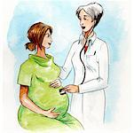
Integrated FANC services
TB
FANC
Malaria
STI
CCC
LAB
PMTCT

Slide 169
TUBERCULOSIS IN PREGNANCY
Tuberculosis is a chronic infectious disease caused by an organism called mycobacterium tuberculosis
TB is one of the leading infectious causes of death among women of reproductive age
Pregnant women who are infected with TB can pass TB to the baby.
During pregnancy the mycobacteria passes through the placenta barrier causing foetal death or infection

Slide 170
Why integration of TB in FANC
Since the onset of HIV epidemic in the early eighties in Kenya, the prevalence of TB has risen sharply
HIV increases the livelihood of developing TB
Pregnancy also increase the likelihood of TB
At least one out of eight HIV pregnant women could have TB (USAID Bureau for Africa, 2000)

Slide 171
Key steps to integrating TB case finding into FANC
Asses client
Refer to laboratory
Refer to TB clinic
Follow up visits: progress in TB Management

Slide 172
Assessing the client
Ask the client the following:
Persistent cough for two weeks or more with or without blood stained sputum
Loss of weight
Fevers that come and go
Excessive sweating at night
Presence of swollen glands

Slide 173
Refer to lab
If the pregnant woman has a cough for two weeks or more explain that three specimens of her sputum must be collected to help confirm the presence or absence of TB

Slide 174
Refer to TB clinic
Explain that TB can be treated over a 6-8 month period and the drugs are safe to use during pregnancy and breastfeeding
If the sputum is positive
Send the woman to the TB clinic directly
Document the positive results in the register
If the sputum is negative but the woman is symptomatic, , send her to the TB clinic anyway
N.B Negative smear test for TB but does not exclude TB
Explain that after delivery, barrier methods of FP are necessary as some TB drugs interfere with the absorption of hormonal contraceptives

Slide 175
TB treatment
If a pregnant woman is confirmed to have TB the treatment will last 6-8 months
Intensive phase (2Months)
RHZE
Continuation phase (4-6) months)
RH(4months)
EH (6 months)
For pregnant women who are HIV+ and also have TB, the TB treatment should be continued and client referred to the CCC
All co-infected patients HIV and TB should be started on cotrimoxazole prophylaxis as it reduces mortality

Slide 176
Follow-up Visits
At each subsequent FANC visit, nurse inquires about TB treatment progress, looks for TB clinic information and documents updates in the register
Continue follow-up into the postnatal period

Slide 177
In summary
Check for signs and symptoms of TB
Procedure for TB diagnosis and referral
Documentation all along the way
Plan for follow-up

Slide 178
Malaria in Pregnancy
Kenya policy on malaria prevention and control during pregnancy in endemic areas emphasizes the use of
IPT
ITN,s
Effective case management of malaria illness and anaemia

Slide 179
What happens when a pregnant woman gets malaria
The woman may have no signs and Symptoms of malaria
The parasites hide in the placenta and may not be found when you take finger blood sample of the mother
The parasites in the placenta interferes with passage of nutrients and oxygen to the unborn baby, slowing down its normal growth

Slide 180
IPT
IPT is an effective approach to preventing malaria in pregnancy by giving antimalarial drugs at defied intervals after quickening to clear presumed burden of parasites
Administer IPT with each scheduled visit after quickening to ensure women receive at least 2 doses at an interval of at least 4 weeks
IPT should be given under DOT in the ANC clinic and can be given on an empty stomach

Slide 181
What is Sulfadoxine Pyrimethamine
It is a combination of two different drugs
500mg Sulfadoxine
25 mg Pyrimethamine
A single dose consists of 3 tablets of Sp taken ay once
There is no evidence that receiving 3 or more doses of SP as IPT will result in increased risk of adverse drug reactions
WHO recommends that SP is safe up to 40 weeks gestation
Taking of folic acid should be delayed for 2 weeks after taking SP
Always ask about side-effects from the first dose of SP before giving the second dose
Sp is given to mothers in endemic areas

Slide 182
ITN
There are two types of treated nets
Insecticide treated nets-requires re-treatment with a recommended insecticide KO Tab
Long lasting insecticidal net-have been specially treated to last for the life time last or 21 washes which ever comes first

Slide 183

Summary: prevention of malaria in pregnancy
Antenatal Care& health education
Intermittent Preventive treatment
Case management of symptomatic women
Insecticide Treated Nets

Slide 184
Summary
TB
FANC
Malaria
STI
CCC
LAB
PMTCT

Slide 185
Reference
MOH-DRH, 2007. Focused Antenatal Care; Orientation package for service providers. 4th Edition

Slide 186
Prevention of Mother to Child Transmission (PMTCT)

Slide 187
Objectives
Describe the MTCT
Describe risk factors associated with MTCT
Describe the PMTCT in Pregnancy, delivery and postpartum
Explain the benefits of PMTCT

Slide 188
Introduction
MTCT (Mother to child transmission) is the transmission of the HIV virus from the infected mother to her baby through:
Pregnancy,
Labour and delivery
Breastfeeding (vertical transmission)
Accounts for over 90% of pediatric infections.

Slide 189
Timing and Magnitude of MTCT of HIV
 | Absolute risk of transmission
During pregnancy | 5-10%
During labour and delivery | 10-20%
During breastfeeding | 5-20%
Overall rate without PMTCT | 25-40%

Slide 190
KENYA
HIV prevalence in pregnancy is 6.3%
~ 97,272 birth to HIV-infected Mothers
~38,900 HIV positive infants p.a assuming 40% transmission without intervention
NB :The target in Kenya is EMTCT( Elimination of Mother to Child Transmission of HIV/AIDS)
I.e. (MTCT rate of <5% among breast feeding populations
or 90% reduction in mother to child HIV transmission rates by 2015)

Slide 191
Preventing mother-to-child transmission (PMTCT) of HIV
Risk factors for MTCT
Viral/ Immunological | Maternal | Obstetric factors | Infant
High viral load | Multiple sexual partners | Invasive foetal monitoring | Preterm delivery Low birth weight
New infection in pregnancy Breastfeeding period | Unprotected sex with HIV infected partner | PROM (> 4 hours) | Neonatal birth injuries Oral candidiasis/sores
Advanced HIV clinical stage | STIs and Malaria in pregnancy | Version (Includes abdominal massage), Routine episiotomy | Vigorous naso-gastric suction
Low CD4 count | Not on ARVS Vitamin A deficiency Mastitis/abscess | APH | Mixed feeding (Increases MTCT by 10 times)
_ | Alcohol and substance abuse Cigarette smoking | Instrumental delivery (forceps, vacuum) | Breastfeeding without ARV

Slide 192
PMTCT: Four-Pronged Approach
Prong 1:
Keep all Women HIV –ve
Prong 4:
Care & Treatment for
HIV infected Women
& their families
Prong 2: Prevent
Unwanted Pregnancies
among HIV+ve women
Prong 3:
PMTCT interventions
among Infected Women

Slide 193
Preventing mother-to-child transmission (PMTCT) of HIV
Benefits of PMTCT include
Improved child health and child survival
Keeping HIV positive mothers alive
Decreased burden to the health care system
Increased public understanding of the HIV/AIDS epidemic
Help increase acceptance of people living with HIV/AIDS (PLWHIV) by reducing stigma and discrimination

Slide 194
Key PMTCT interventions
For all women during pregnancy, labour, delivery and post delivery period
Treat clients with dignity and privacy
Good interpersonal communication skills
A thorough history taking and physical examination
Antenatal profile
Offer HIV testing and counseling to all women (Opt out approach) and retest all HIV negative women after 3 months
Counsel all women on
Importance of early ANC, (4 targeted FANC visits)
Prevention of malaria in pregnancy strategies (malaria interacts with HIV)

Slide 195
Antenatal Care and Prevention of MTCT of HIV
Use Essential Package of Integrated Antenatal Care Services which include:
Group Education
Client history
Physical examination
Abdominal and genital examination
ANC profile
Counselling on birth preparedness, danger signs, infant feeding

Slide 196
Antenatal Care and Prevention of MTCT of HIV
CONT……
Nutritional assessment, counselling and education
Counselling on HIV/AIDS
Counselling HIV –ve woman and her partner
RTI, TB screening
TT, Antimalarials, ITNs
ARV and OI prophylaxis and treatment
Prevention with positives and effective contraceptive plan

Slide 197
Preventing mother-to-child transmission (PMTCT) of HIV
SPECIFIC INTERVENTIONS FOR PMTCT DURING ANC, L/D AND POST DELIVERY PERIOD (For HIV Positive women )
Prenatal and ANC | Labour and Delivery | Post delivery
History of previous Opportunistic infections (OIs) | Skilled delivery | Maternal ART/ARV prophylaxis, CTX (integrated in MCH)
Targeted physical exam | ART/ARV prophylaxis, CTX, Psychosocial support(PSS) | Universal precautions, avoid vigorous suction of infants,
CD4, Viral load where applicable, | Birth companion | Infant ARV prophylaxis, CTX from 6 weeks

Slide 198
Preventing mother-to-child transmission (PMTCT) of HIV
SPECIFIC INTERVENTIONS FOR PMTCT DURING FANC, L/D AND POST DELIVERY PERIOD (HIV Positive women)
Prenatal and ANC | Labour and Delivery | Post delivery
Partner testing | Universal precautions, Use partograph, avoid ARM, prolonged PROM /labour, episiotomy | Support chosen option for IYCF, Nutrition counselling
ART/ARV prophylaxis, CTX PSS.(integrated in MCH) | Initiate chosen option for Infant and young child feeding (IYCF) | Psychosocial support Linkage to chronic HIV care
Offer additional ANC visits | Avoid PPH | Early infant diagnosis (EID)- see algorithm in the guideline, Immunizations, LLIN
LLIN, Nutrition counselling | Hygiene and infection prevention counselling | Cervical cancer screening and FP

Slide 199
Preventing mother-to-child transmission (PMTCT) of HIV
Criteria for initiation of ART (Lifelong )
CD4 ≤350 irrespective of the WHO stage
WHO stage 3, 4 regardless of CD4
All patients with HIV and TB
ART for PMTCT and mothers own health
What to start
AZT+3TC+ NVP or EFV* or LPV/r
*(EFV-not to be used in first Fourteen weeks of pregnancy)
Patients on ART at conception should continue the regimen (Regimen switching may be necessary)
Notes:
AZT can be substi

Slide 200
Preventing mother-to-child transmission (PMTCT) of HIV
Recommendations for ARV prophylaxis for HIV positive women
Criteria for ARV Prophylaxis: option A
–WHO Clinical stage 1& 2
–CD4 count >350 cells/mm3
Antenatal–
AZT 300 mg twice daily starting at 14 weeks or soon thereafter . AZT may be started at any other time up to 38 weeks. No dietary restrictions.
Intrapartum
AZT 600 mg stat (or 300mg BD) + 3TC 150mg BD + single-dose NVP200 mg at onset of labour
Post partum
AZT 300mg BD +3TC 150mg BD for seven days

Slide 201
Special circumstances for HIV positive women
In settings with the capacity to initiate and monitor triple therapy (Option B plus),
Triple ARV prophylaxis (HAART) can be used in women who meet the above criteria.
Current evidence shows that once started , they should continue for life
Where available and feasible, women with viral load >1000 copies at term,
should be offered elective CS
ARV choice in severe anaemia (Hb <8 g/dl):
AZT is contraindicated.
Initiate ART with TDF in place of AZT irrespective of WHO stage and CD4 count. (Regimen: TDF+3TC+NVP/EFV).
Transfuse irrespective of gestation if Hb < 6g/dl

Slide 202
Preventing mother-to-child transmission (PMTCT) of HIV
Extended Infant NVP prophylaxis dosing Birth - 6 weeks Birth weight <2,500gms 1 ml OD (10mg daily ) Birth weight >2,500gms 1.5ml OD (15mg daily)
6 weeks to 3 months | 2ml OD (20mg daily)
>3months to 6 months | 2.5 ml OD (25mg daily)
>6 to 9 months | 3 ml OD (30mg daily)
>9months to end of BF | 4ml OD (40mg daily)

Slide 203
Note:
AZT 15mg/kg twice daily for 6 weeks is an alternative for infants who are not breast fed or whose mothers are on ART/triple prophylaxis
3TC is an alternative for infants with severe NVP toxicity (grade 3 or 4)/or if baby is on TB treatment with rifampicin containing regimen

Slide 204
Preventing mother-to-child transmission (PMTCT) of HIV
Safer Infant feeding choices
All mothers who are HIV-negative or are of unknown HIV status should be encouraged and supported to
Exclusively breastfeed for the first 6 months
Continue breastfeeding with appropriate complementary feeds introduced thereafter.
All HIV-positive mothers should be given accurate information on
Infant feeding options including the challenges
Benefits of each option in order to help them make an informed decision on which infant feeding option best suits their circumstances

Slide 205
Safer Infant feeding choices
Breastfeeding with infant ARV prophylaxis is recommended for HIV positive mothers.
They should be encouraged and supported to exclusively breastfeed for the first 6 months
Mothers should continue feeding with appropriate complementary feeds thereafter.
Infants of these mothers should receive Nevirapine prophylaxis throughout breastfeeding and until one week after complete cessation of breastfeeding

Slide 206
Safer Infant feeding choices
All HIV-positive mothers who choose not to breastfeed (meet AFASS criteria) should be counseled and supported
To provide exclusive replacement feeding for the first 6 months
To introduce appropriate complementary feeds thereafter.
Infants of these mothers should be provided with Nevirapine prophylaxis from birth until 6 weeks of age
AFASS- Acceptable, Feasible, Affordable, Sustainable and Safe

Slide 207
Preventing mother-to-child transmission (PMTCT) of HIV
Safer Infant feeding choices cont..
Mixed feeding i.e. feeding both breast milk and other foods or liquids to an infant less than 6 months of age is strongly discouraged as it is associated with an increased risk of HIV transmission to the infant (10.8 times)

Slide 208

Preventing mother-to-child transmission (PMTCT) of HIV
Continuum of care
Link HIV-infected mothers and their families to
HIV-related treatment, care, support within the healthcare setting
The community including Male partner involvement
Integrating a comprehensive prevention of MTCT of HIV with MCH programs
Significantly reduce the number of HIV- infected infants
ART services should be integrated in MCH at least up to 18months

Slide 209
Preventing mother-to-child transmission (PMTCT) of HIV
Continuum of care services include:
Prevention and treatment of opportunistic infections
Good nutrition
Social support
EID, CTX, ART for HIV positive infants,
FP, Nutrition , risk reduction, and other Prevention with Positive (PwP) package
Disclosure and male involvement
ART for mother and partner (Linkage to CCC)

Slide 210
Preventing mother-to-child transmission (PMTCT) of HIV
SUMMARY: how to prevent MTCT
Don’t discriminate against HIV+ people!
Encourage every pregnant woman to get tested for HIV
Encourage every pregnant woman to seek early antenatal care
Encourage every pregnant woman to deliver at a health facility or clinic with PMTCT services
Provide counseling about infant feeding choices
Counseling on family planning (dual method) to prevent pregnancy in HIV positive women
Counsel on Adherence to ART/ARV prophylaxis

Slide 211
Assignment
Review the WHO HIV staging
Review the classification of ART

Slide 212
HIV IN PREGNANCY

Slide 213
introduction
HIV is a family infection
Mothers and fathers have an impact on transmission of HIV to the baby
There is increased chance of transmission to the baby when a woman becomes infected with HIV when she is pregnant or breastfeeding
Partners should have safer sex throughout pregnancy and while breastfeeding

Slide 214
Pregnancy Outcome: Goals
Uncomplicated pregnancy
Healthy, uninfected infant
Healthy mother who has not compromised her future options for HIV therapy

Slide 215
Current Status of Mother-to-Child Transmission
Estimates of HIV transmission rates from women to children are about 20-40%
MTCT is by far the largest source of HIV infection in children under 15

Slide 216
Effects of pregnancy on HIV/AIDS
Immune response is suppressed
CD4 counts decline more rapidly compared to non-pregnant women
At increased risk of UTI
It may accelerate the progress to full blown AIDS or quicker deterioration if the final stage of AIDS.

Slide 217
Effects of HIV/AIDS on the pregnancy
Associated with other STIs
They are more likely to have candidal vaginitis
in crease of other infections e.g UTIs
Rate of ectopic pregnancy is 4 times higher in HIV +ve women.
Higher rates of abortions and stillbirths have been reported in some African studies
Preterm labour and PPROM

Slide 218
Effects of HIV/AIDS on the pregnancy cont…
Higher rate of abruptio placenta in HIV +ve women.
Chorio-amniotis is more common in women with HIV infection.
HIV is a major cause of anaemia in pregnancy in Africa

Slide 219
PREVENTING MOTHER TO CHILD TRANSISSION (PMTCT) OF HIV
MTCT occurs when the HIV virus is passed from the mother to the baby
This happens as follows.
During pregnancy5-10%
During labour and delivery 10-20%
During breastfeeding 5-20%

Slide 220
BENEFITS OF PMTCT
Improved child health and child survival
Decreased burden to the health care system
Increased public understanding of the HIV/AIDS epidemic
Help increase acceptance of people living with HIV/AIDS

Slide 221
FOUR PILLARS OF WHO TO REDUCE MTCT
Preventing of unintended pregnancy in HIV+ women through family planning.
Prevention of HIV infection in women through use of ABCD
PMTCT in pregnancy: testing and counselling to identify HIV+ women; provide ARVS to mother and baby; use of infection prevention practices.
Care and support o those living with HIV/AIDS.

Slide 222
Risk factor for MTCT
Viral factor
Clinical stage of infection: new and advanced infections
Low maternal CD4 count( the number of cells per cubic millimetre of blood)
High viral load in blood and genital tract

Slide 223
Maternal factors
Vitamin A deficiency
Unprotected sex with an infected partener
Mother not taking ARV agents
HIV infection during pregnancy
Malaria infection in pregnant women.
Unprotected sex with multiple parterners
Substance abuse
Smoking
STIs and other co infections

Slide 224
Obstetric factors
Invasive fetal monitoring
Routine episiotomy
Placental disruption
Prolonged rupture of membranes (>4 hours)
Injury to birth canal during child birth
Antepartum procedures
Acute chorioamnionitis
Instrumental delivery
Mixing of maternal and fetal body fluids

Slide 225
Infant factors
Breastfeeding
Preterm delivery
Neonatal birth injuries
Vigorous naso-gastric tube suction

Slide 226
Antenatal care
Primary prevention during pregnancy
Education about safer sex with use of condoms for mother and father
Early treatment of STIs
Safer sex during pregnancy and lactation
Offer VCT to all pregnant women
Antenatal visits are vital opportunities for PMTCT for both HIV-positive and HIV-negative women

Slide 227
Initial examination
All pregnant women
Syphilis test
Hgb
HIV counseling and consent
HIV test (rapid, if available)
Rule out active TB
If HIV positive:
Baseline TLC
CD4 and CD8 counts
CD4/CD8 ratio and all other baseline tests (CBC, LFT, etc.)
Viral load screening

Slide 228
Initial examination cont…
Additionally, if HIV+:
Duration of known HIV+ status
Past history of HIV-related illness and HAART
WHO Staging
Status of other children, partner, and partner disclosure and referral
Any medications taken for HIV-related illness since beginning of pregnancy

Slide 229
Assess Maternal Psychosocial Status
Generalities and pains
Headaches
Anxiety
General malaise
Depression
Palpitations
Insomnia
Irritability

Slide 230
Care of the HIV+ Pregnant Woman
Treatment:
OIs
STI
UTI
Vaginal candidiasis
ARV
Vitamin supplements
Prophylaxis:
Anemia
Tetanus (Toxic-TT)
Vitamin deficiency
Malaria
Pneumonia (PCP)
TB

Slide 231
Best practices during FANC
Treating clients with dignity and privacy
Using good interpersonal communication skills
Clean, safe service delivery points, with well organised client flow.
Providing access to consistent services.
Self assessment by providers themselves
A thorough history taking and physical examination.

Slide 232
Best practices during FANC cont..
Every pregnant woman should be offered HIV testing.
HIV testing should be voluntary.
PMTCT depends on being able to identify women who can benefit from interventions.

Slide 233
Care of HIV +ve women in FANC
Women with HIV should have medical care during pregnancy
Look for and treat other infections.
Nutritional counselling and supplements
Monitor the HIV infection
Counselling about infant feeding, other infections, danger signs, condo

Slide 234
Care of HIV +ve women in FANC
Antiretroviral treatment
The main aim is to prevent MTCT which may be lowered by 60-70%
ante partum AZT –ZDV 300 mg bid or 200mg tid given from 14 weeks
Intrapartum- IV ZDV loading dose of 2mg/kg in one hour, followed by 1mg/kg till delivery.
Postpartum ZDV syrup at 2mg/kg q 6hour to a newborn began at 8-12 hour for 6 weeks.

Slide 235
Management during labour
Antiretroviral therapy
The mother should take nevirapine at the onset of labour
Prevention of injury to the fetus
The following procedures should be avoided
Artificial rupture of membranes
Scalp electrodes
Amnioinfusion
Amniocentesis
Forceps and vacuum delivery
Oropharngeal suctioning of the newborn to prevent injury to the mucosa

Slide 236
Management during labour cont…
Prevention of contamination with maternal blood and fluids
Perineal trauma and episiotomies should be avoided
Baby should be wiped immediately after birth.
Prevention of intrauterine contamination with vaginal secretion
Shorten length of ruptured membranes to less than 4 hours
Limit the number of vagina examination

Slide 237
Management during labour cont..
Prevent and treat other infections and complications.
Check for and manage UTIs at the start of labour
Active management of third stage of labout to prevent PPH.
Caesarian section
The incidence of MTCT is lower in cases of elective CS

Slide 238
Management during postpartum
Exclusive breastfeeding reduces the chance of HIV transmission to the baby.
Mixed feeding, presence of mastitis and cracked nipples increases the risk of HIV transmission.
Breastfeeding should be exclusive for 6 months, if breastfeeding is chosen teach the mother good breastfeeding technique to avoid cracked nipples and mastitis which can increase MTCT.

Slide 239
formula feeding
AFASS criteria to see if mother is able to follow exclusive formula feeding(EFF)
Acceptability: is EFF acceptable for the mother
Feasibility: is the mother able to begin EFF correctly for the required period
Affordability: is the mother able to afford the cost of EFF
Sustainability: will the mother be able to continue the recommended EFF standards for the required period
Safety: will the mother be able to practice EFF safely

Slide 240
Birth control for HIV +ve women
Condoms are the best choice as they also prevent HIV transmission

Slide 241
MATERNAL PHYSIOLOGY DURING PREGNANCY
INTRODUCTION
The physiologic , biochemical and anatomic changes that occur during pregnancy are extensive and may be systemic or local
Most systems return to normal pre-pregnancy status between the time of delivery and 6 weeks postpartum.
An understanding of normal physiologic changes induced by pregnancy is essential in understanding coincidental disease process

Slide 242
Gastro intestinal tract
Pregnant women tent to rest more often ,conserving their energy thereby enhancing fetal nutrients.
Some mothers appetite increase leading to increased food intake and some have decreased appetite or experience nausea and vomiting.
These symptoms are related relatively to hcg levels

Slide 243
cont
Oral cavity
Increased salvation which is more acidic –increasing chances of tooth decay.
Gums are hypertrophic and hyperemic ,they also become spongy and friable and so bleeds easily.
These is due to systemic estrogen, though oral and vitamin C deficiency may cause similar problem.

Slide 244
General motility
Reduced gastro intestinal motility –leading to slow gastric emptying causing constipation.
There is decreased smooth muscle tone
This is due to increased level of progesterone.
Stomach and oesophagus
There is increased production of Hcl mostly the 1st trimester but usually there is low Acidity.
Gastrin hormone witch is also manufactured by the placenta increase leading to increase to stamach volume and decreased stomach

Slide 245
cont
Ph (acidic)
Increased gastric mucus production
Decreased oesophangel peristalsis later accompanied by gastric reflux because of slow emptying and dilation or relaxation of cardiac sphincter, gastric reflux is commmon in later pregnancy due to stomach elevation by enlarging uterus.
Small ,large intestine and the appedix
Small and large moves upward and laterally due to enlarging uterus ,stomach moving upwards.

Slide 246
cont
Appendix is displaced superiorly in the Rt lumber/flank.
Gall bladder
Emptying of bile is slow due to hypotonia of smooth muscles
Bile stasis may cause bile stone
Plasma cholinesterase (breaks Acetycholine) activity is altered.

Slide 247
Liver
No morphologic changes but functional alterations.
There is increased serum alkaline phosphatase activity because of increased placenta alkaline isozymes.
Decreased plasma albumin and plasma globulins so that the ratio decreases where in normal cases is an indication of liver disease.

Slide 248
Genital urinary system.
Kidney
There is renal dilatation and the kidney increases in length by 1-1.5cm and wt too.
Renal pelvis dilate upto 60mls (10mls is the normal volume in non pregnancy)
Ureters –dilate above the brim of the bony pelvis.
Become elongated widen and become more curved leading to urine stasis thus causing hydroureters and hydronephrosis due to

Slide 249
cont
1. increased progesterone cause hypotonia to smooth muscle in the ureters.
2. ovarian vein complex may enlarge to compress the ureters
3. Dextrorotation of uterus.
Hyperplasia of smooth muscles in distal 1/3 of ureters may cause reduction in luminal size leading to dilatation in upper 2/3
Note the effect of stasis may lead to recurrent UTI and so renal function test in pregnancy become difficult to interpret.
.

Slide 250
Renal function
The urinary system appears more efficient during pregnancy.
These is due to increased maternal and placental hormones Adrenacorticotrophic hormone (ACTH) ,ADH, Aldesterone,Cortisol, human chorionic somatomammotropin (hcs), thyroid hormones.
There is increased plasma volume leading to increased glomerular filtration rate by a bout 50% until 20wks postpartum

Slide 251
cont
Renal plasma flow increases by 25-50 % through out early and mid pregnancy. In late pregnancy it remains constant.
About 20% of cardiac output is delivered to the kidneys and as much as 50% is reabsorbed in proximal tubules independent of hormonal control.
Despite increased GFR volume of urine still remains normal due to sodium re-absorption In distal tubules in response to Aldosterone

Slide 252
cont
Creatinine clearance decreases as term approaches.
Blood urea Nitrogen is reduced .
Glycosuria during pregnancy is not necessary abnormal ,this due to increase in GFR with impairment of tubular re absorption capacity for filtered glucose. Its not related to blood glucose though should be monitored to R/O DM
There is increased loss of nutrients in urine e.g amino acids, H2osoluble vitamins etc

Slide 253
cont
Renin ezymes increases until term and acts on angiotensinogen in the liver converting angiotensin 1 and 2 which is a vasoconstrictor but it does not occur and so no rise in BP (normal pregnancy are resistant to the pressor effect of increased levels of angiontensin 2 but those with PET are not resistant
Angiotensin 2 stimulate adrenocortical secretions of aldosterone which in conjunction with ADH encourages salt and H2o retention in pregnancy.

Slide 254
bladder
Uterus enlarges and bladder is displaced upward and flattened in the ant posterior diameter.
This pressure leads to increased urinary frequency and urgency
Bladder vascularity increases and muscle tone decreases leading increased capacity upto 1500mls

Slide 255
Haematologic sysytem
Blood volume;
Increase in blood volume depend on the size of women, no of pregnancies she has had , no of deliveries and either one or multiple fetuses.
Hypervolaemia begin in 1st trimester and increases rapidly in 2nd trimester and plateus at 30/wks G.A
Mechanism of increased blood volume is not understood but increased Aldosterone, estrogen and progesterone are believed to be responsible.

Slide 256
cont
The extra blood is needed for;
Extra blood flow to the uterus
Extra metabolic needs for the fetus
Increased perfusion of other organs ,i.e kidneys
To the skin to allow dissipation of heat due to increased metabolic rate.
Compensation of maternal loss during delivery.(SVD 300-500mls)

Slide 257
RBCs
RBC mass increases to about 33%=450mls of erythrocytes.
Erythrocytes volume increases steadily with or no Iron supplement given, though increase is greater with supplement.
Haematocrit (pvc) falls until end of 2nd trimester because plasma volume increase earlier in pregnancy and faster than RBC.

Slide 258
IRON
Increase in RBC levels leads to increase need for iron for production of haemoglobin .if supplement iron is not added then there will be iron deficiency anaemia
If iron is not readily available ,the fetus uses the iron from the maternal stores.
Production of fetal haemoglobin is adequate even if mother is severely anaemic.
WBC
Total wbc increase during pregnancy to above 1200microm/l

Slide 259
cont
Lymphocytes and monocytes are usually normal
Polymorph nuclear leucocytes are the primary contributor to WBC increase
Basophils decrease slightly.
PLATELLETS
Increased thrombocytopoesis is accompanied by progressive platellets consumption .
Clotting factors.
Lvels of essential coagulation factors increase.

Slide 260
cont
Mostly in fibrinogen –Factor 1and 8 are highly increased while Factor 7, 9.10,12 and less increased.
Plasma fibrinogen concentration increase from normal non pregnant 1.5-4.5g/l to 4.5-6.5g/l in late pregnancy.
Factor 2 and 5 remains normal or increase slightly
Understanding of these physiologic changes is necessary in management of Hemorrhage, Thrombo embolic disorders which are both caused by hemostsis disorders.

Slide 261
CVS
Uterus enlarges-diaphragm and Heart is displaced upward to the left so that the Apex is moved laterally.
Cardiac capacity increases by 70-80 mls due to increased volume or hypertrophy of cardiac muscle and so heart size increases by 12%
No pathological murmurs may occur but physiologic murmur may occur due to anatomic changes and mostly systolic or injection murmur.

Slide 262
cont
Cardiac output increases to about 1.5l/min over the normal 2.5-4.5 l/min/m2
Heart rate increases with G .A and at term is approximately 15b/min higher than normal.
BP
Declines slightly
There is slight changes in systolic BP but diastolic BP is reduced by 5-10 mmHg from about 12-26 weeks
Venous pressure in upper body is unchanged but in lower extremities it increases with G.a

Slide 263
cont
As the uterus compress the inferior vena cava leading to reduced cardiac output the low BP thus causing oedema of the lower limbs.
Effect of labour on cvs
When mother is supine position uterine contractions cause;
25% increase in maternal cardiac output
15% decrease in Heart rate.
33% increase in stroke volume
But in lateral position these hemodynamic parameters stabilizes with

Slide 264
cont
7.5% increase in maternal cardiac output
0.7% decrease in Heart rate
7.7 % increase in stroke volume
These differences are due to inferior vena cava occlusion by gravid uterus .
Cardiopulmonary blood volume increases byb300-500mls during contractions.

Slide 265
Respiratory system
Dead space volume increase due to muscle relaxation.
Tidal volume increases
Inspiratory capacity reaches maximum at 24wks G.A.
Increased respiratory rate.
Increased O2 consumption due to increased metabolic rate of the mother and the fetus.
There is decrease by 20% in
Total lung capacity due to diaphragm elevation

Slide 266
cont
Functional residual capacity
Residual volume
Expiratory reserve volume
Note –as respiratory minute volume increase hyperventilation of pregnancy occur causing
Decrease in alveolar CO2 which
Lower maternal blood CO2 tension
So alveolar O2 tension is maintained

Slide 267
Effects of labour in RS
During labour –anxiety ,fear, emotional reactions may affect the depth and rate of respiration consequently CO2 content of blood.
This lead to patient becoming dyspnoenic , hyperventilate and develop respiratory Alkalosis leading to carpopedal spasm and Acid base imbalance.pt also have tingling sensation due to increased excitability of peripheral nerves due to Alkalosis and low serum calcium levels

Slide 268
cont
Pts may present with tremors or fits of the carpal joints, hands, feet's, mouth and sometimes the whole body.
Assignment.
Make notes on metabolic changes.

